Slide 1

FastGAN: Faster and Stabilized GAN
Mauro Ficorella 1941639 | Martina Turbessi 1944497 | Valentina Sisti 1952657

Slide 2
Introduction
Our work is based on the paper “Towards Faster And Stabilized Gan Training For High-fidelity Few-shot Image Synthesis”.
OBJECTIVES:
Allow users with limited computing budget and resources to train a GAN;
Eliminate the requirement of a big dataset for training;
Allow to train models from scratch in order to avoid biases typic of the pre-trained models and to let people use their own set of interest images;
Few hours required for training time;

Slide 3
IMPLEMENTATION
Python
TensorFlow
NVIDIA CUDA + cuDNN
HARDWARE ADOPTED:
NVIDIA GeForce RTX 2070 SUPER (8GB of VRAM)
NVIDIA GeForce GTX 1050-Ti (4GB of VRAM)

Slide 4
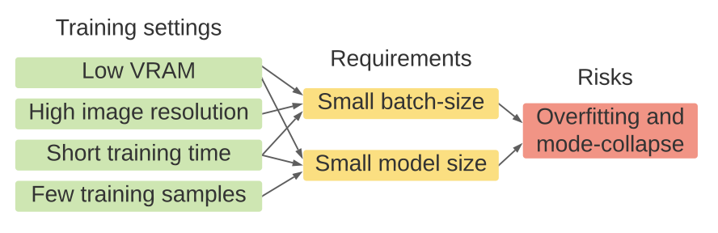
Gan’s Problems
Accelerate training: this problem has been approached from various perspectives, but this brought only very limited improvements in training speed, while not enhancing quality within the shortened training time;
High resolution training: this made GAN much harder to converge. There were some approaches trying to solve this problem, but they led to a slightly greater computational cost, consuming more GPU memory and requiring more training time;
Stabilize training: mode-collapse on the generator is a big challenge when training GANs, given fewer training samples and lower computational power and budgets (smaller batch-size). There were approaches that tried to solve this problem, but they worked only on low resolution images with unlimited computing resources.

Slide 5
FastGAN Solution
FastGAN reaches the objectives based on the following two techniques:
Skip-Layer channel-wise Excitation module: revises channel responses on high-scale feature-maps using low-scale activations and allows to reach a faster training using a more robust gradient flow throughout the model weights;
Self-supervised discriminator D trained as a feature-encoder with an extra decoder: this discriminator is forced to learn a feature-map that covers more regions from an image in input; in this way it gives richer signals in order to train G. It has been shown that auto-encoding is the best self-supervision strategy for D.

Slide 6
FastGAN method
In order to optimize GANs with respect to the SOTA models, in FastGAN is adopted a lightweight model, using a single convolutional layer on each resolution in the generator.
On the high resolutions in both generator and discriminator, only three channels for the convolutional layers are applied in input and output. This structure helps making FastGAN faster to train, remaining, at the same time, strong on small datasets.

Slide 7
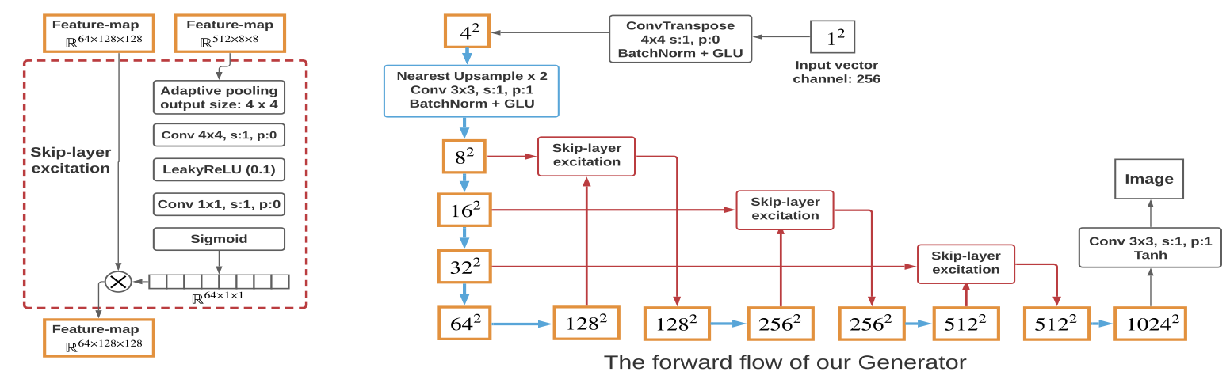
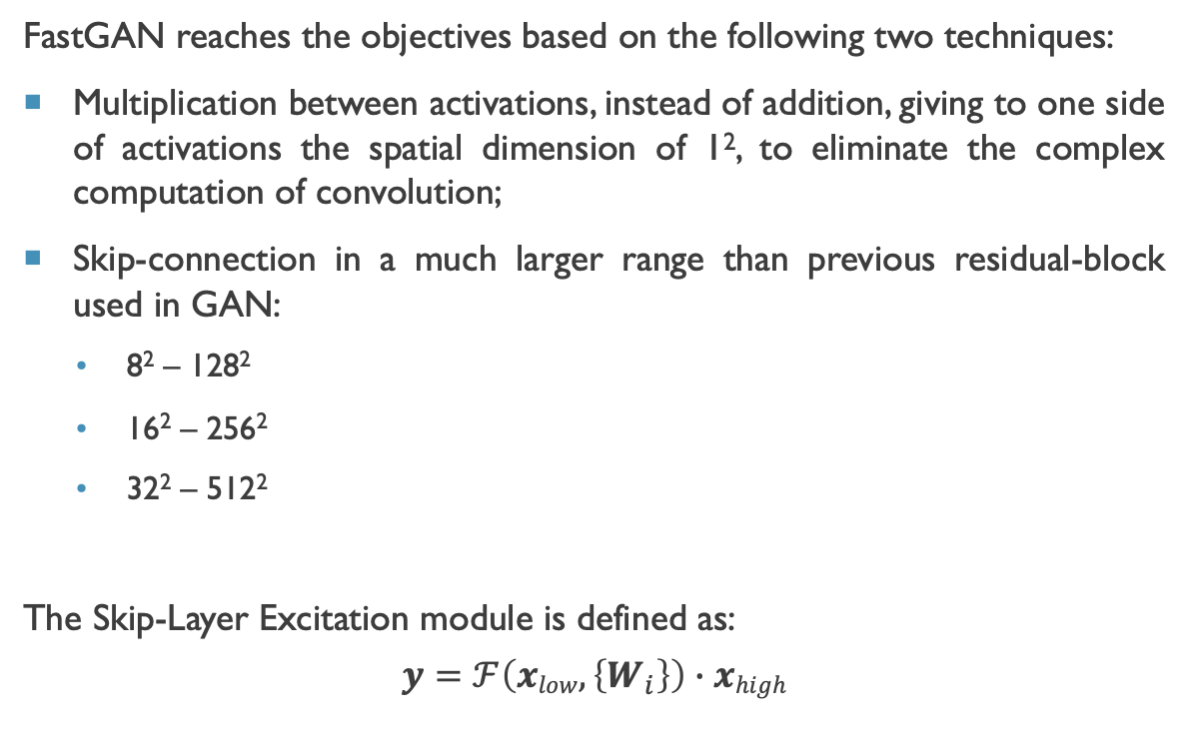
Method: Skip-Layer Channel-Wise Excitation
FastGAN reaches the objectives based on the following two techniques:
Multiplication between activations, instead of addition, giving to one side of activations the spatial dimension of 1², to eliminate the complex computation of convolution;
Skip-connection in a much larger range than previous residual-block used in GAN:
8² – 128²
16² – 256²
32² – 512²
The Skip-Layer Excitation module is defined as:
$$y=ℱ\left(xlow, \left\{W_{i}\right\}\right)∙xhigh$$

Slide 8
Method: Generator
Generator’s adversarial loss function:
$$ℒ_{G}=−𝔼_{z\sim 𝒩}[D(G\left(z\right))]$$

Slide 9
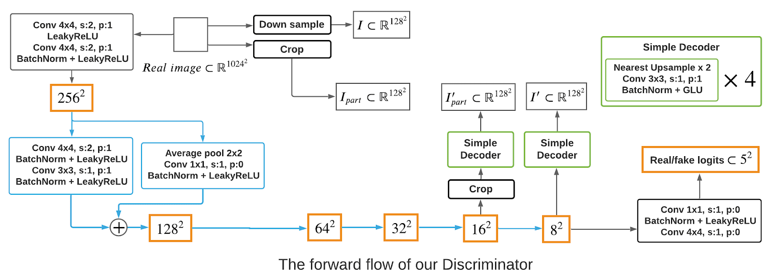
Method: Self-Supervised Discriminator

Slide 10
Method: Self-Supervised Discriminator
Discriminator’s adversarial loss function:
$$ℒ_{D}=−𝔼_{z\sim Ireal}\left[min\left(0, −1+D\left(x\right)\right)\right]−𝔼_{\hat{x}\sim G\left(z\right)}\left[min\left(0, −1−D\left(\hat{x}\right)\right)\right]+ℒ_{recons}$$

Slide 11
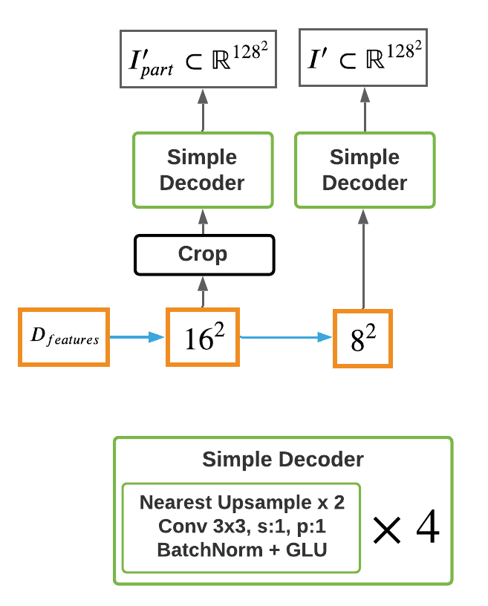
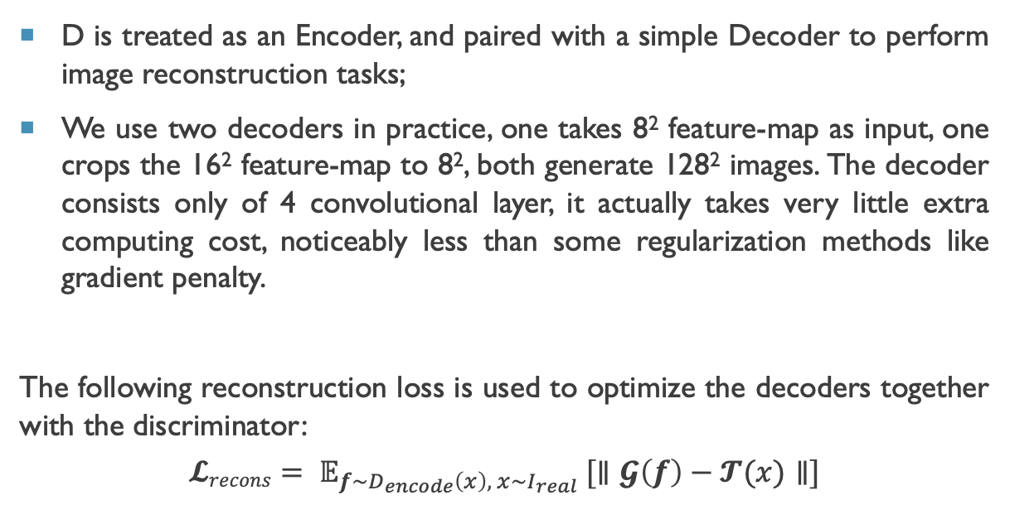
Method: Self-Supervised Discriminator
D is treated as an Encoder, and paired with a simple Decoder to perform image reconstruction tasks;
We use two decoders in practice, one takes 8² feature-map as input, one crops the 16² feature-map to 8², both generate 128² images. The decoder consists only of 4 convolutional layer, it actually takes very little extra computing cost, noticeably less than some regularization methods like gradient penalty.
The following reconstruction loss is used to optimize the decoders together with the discriminator:
$$𝓛recons= 𝔼_{f\sim D_{encode}\left(x\right), x\sim I_{real}} [∥𝓖\left(f\right)−𝓣(x)∥]$$
Discriminator’s adversarial loss function:
$$𝓛_{D}=−𝔼_{z\sim I_{real}}\left[min\left(0, −1+D\left(x\right)\right)\right]−𝔼_{\hat{x}\sim G\left(z\right)}\left[min\left(0, −1−D\left(\hat{x}\right)\right)\right]+𝓛_{recons}$$

Slide 12
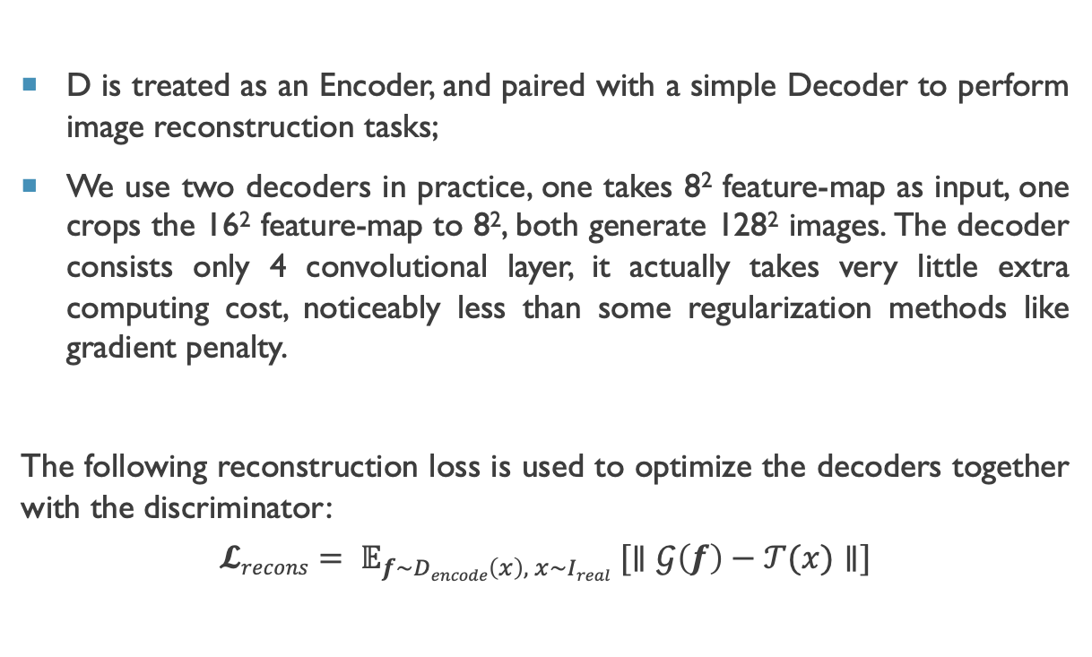
Method: Self-Supervised Discriminator
D is treated as an Encoder, and paired with a simple Decoder to perform image reconstruction tasks;
We use two decoders in practice, one takes 8² feature-map as input, one crops the 16² feature-map to 8², both generate 128² images. The decoder consists only 4 convolutional layer, it actually takes very little extra computing cost, noticeably less than some regularization methods like gradient penalty.
The following reconstruction loss is used to optimize the decoders together with the discriminator:
$$𝓛recons= 𝔼_{f\sim Dencode\left(x\right), x\sim Ireal} [∥𝒢\left(f\right)−𝒯(x)∥]$$

Slide 13
other methods
The model is built starting from a baseline model that is made of the following methods:
Batch-normalization;
Differentiable-augmentation;
ADAM optimization on G;
GLU instead of ReLU in G.

Slide 14
Metric: FID
The metric used in our work is FID:
Calculates the distance between feature vectors calculated for real and generated images;
Summarizes how similar the two groups are in terms of statistics on computer vision features of the raw images;
Lower scores indicate that the two groups of images are more similar.

Slide 15
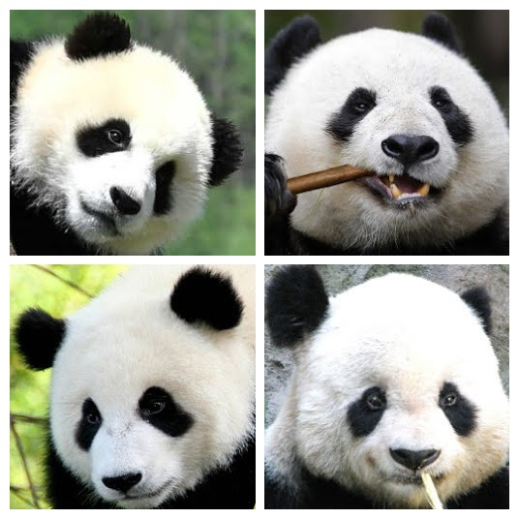
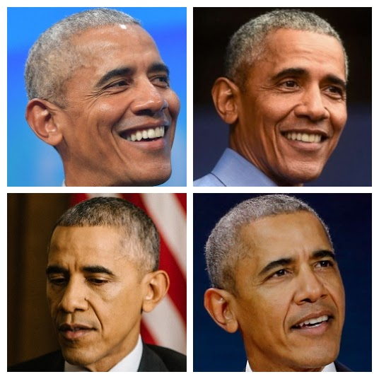
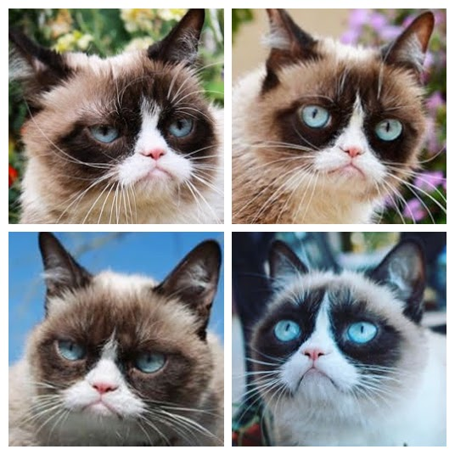
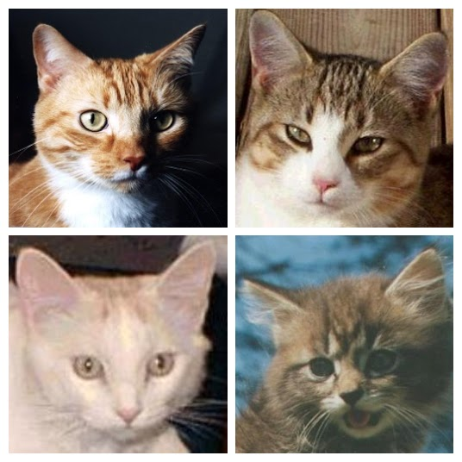
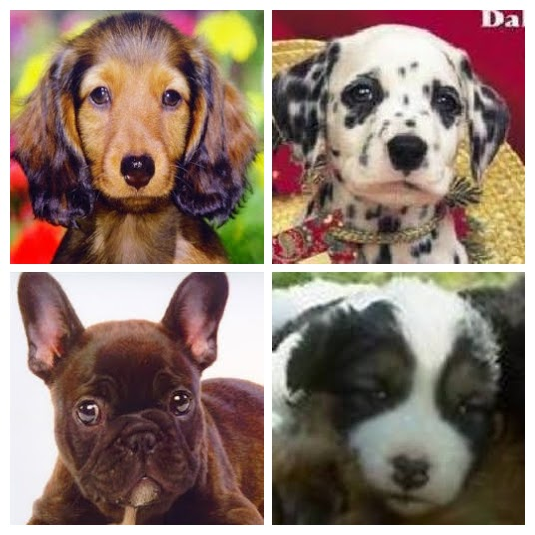
dataset
We used the following datasets of resolution 256 × 256:
Panda
Obama
Animal-Face Dog
Animal-Face Cat
Grumpy-cat

Slide 16
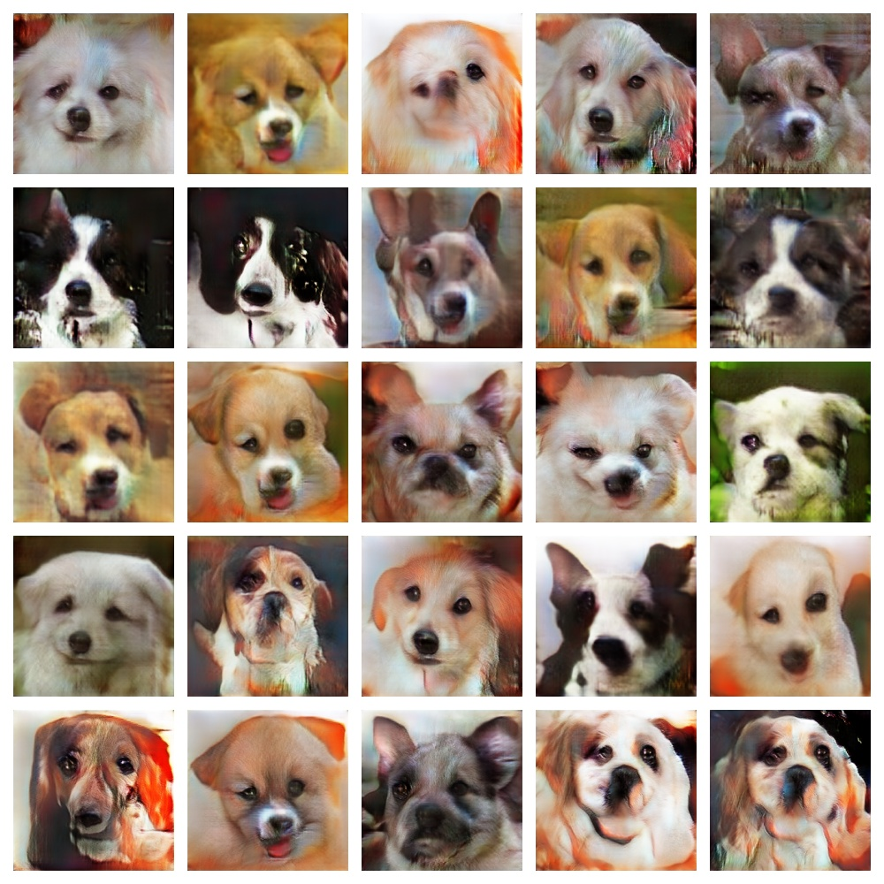
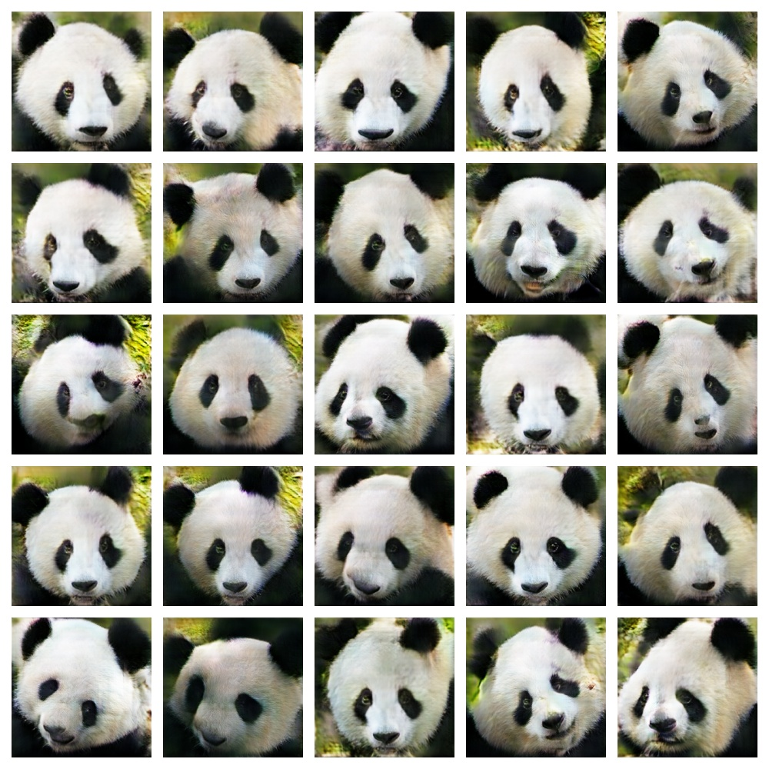
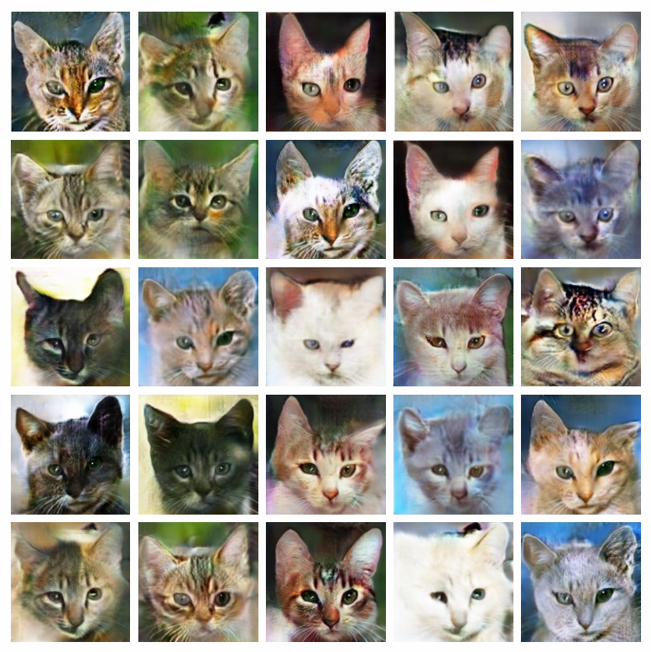
RESULTS
∼13.5hrs for 1400 epochs on the 2070 SUPER
∼4.5hrs for 1000 epochs on the 2070 SUPER
∼45hrs for 1800 epochs on the 1050-Ti

Slide 17
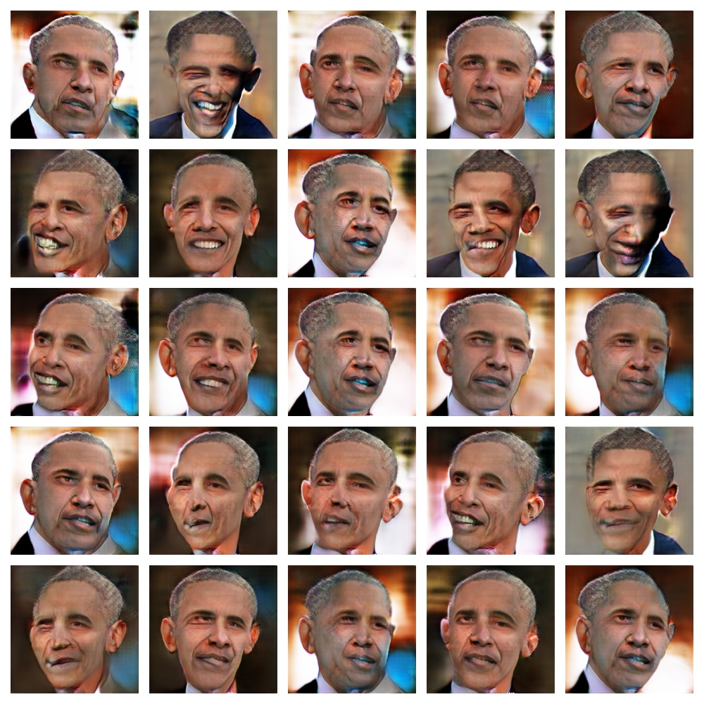
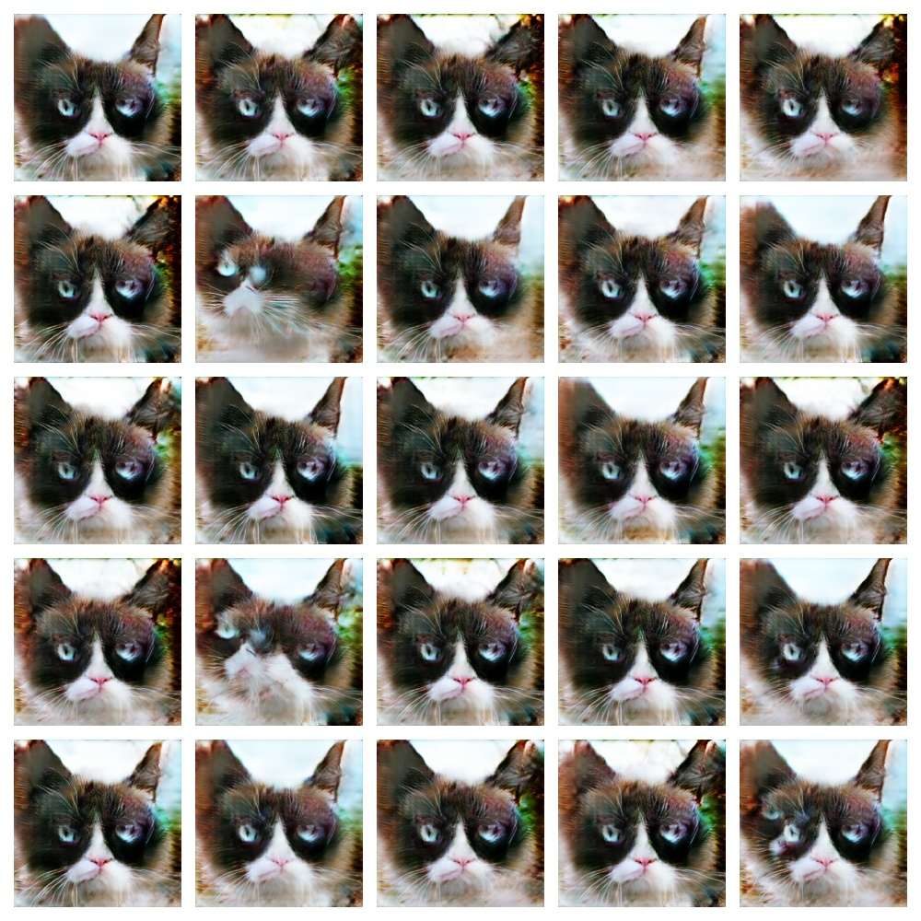
RESULTS
∼7hrs for 1700 epochs on the 2070 SUPER
∼4.5hrs for 1000 epochs on the 2070 SUPER

Slide 18
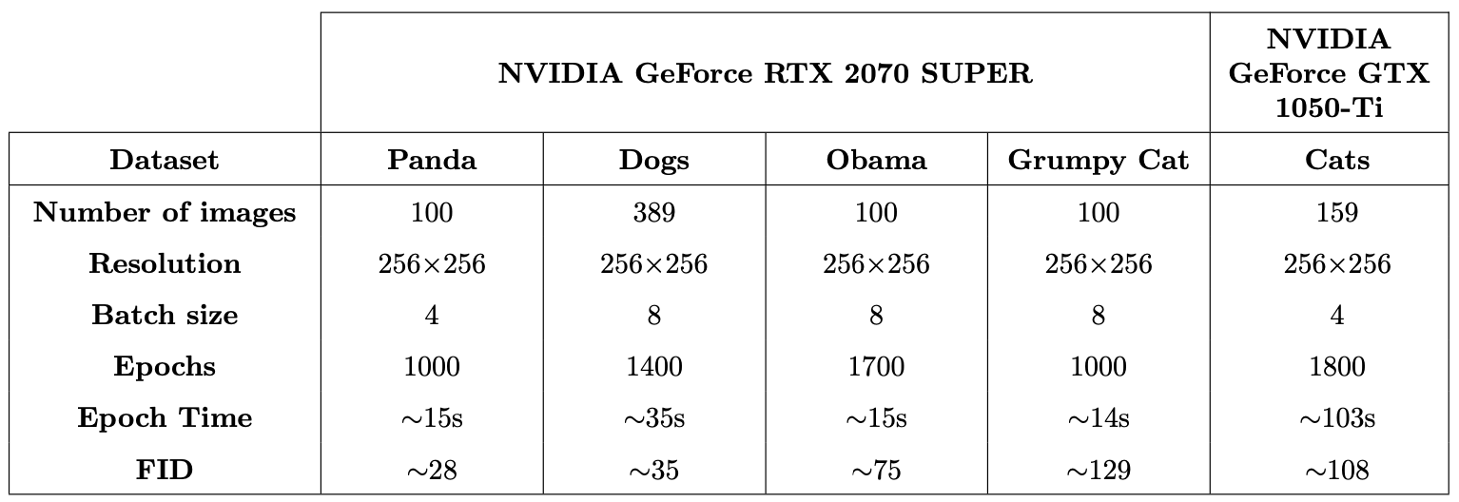
SUMMARIZING THE RESULTS
Training parameters and results on NVIDIA GeForce RTX 2070 SUPER and NVIDIA GeForce GTX 1050-Ti

Slide 19
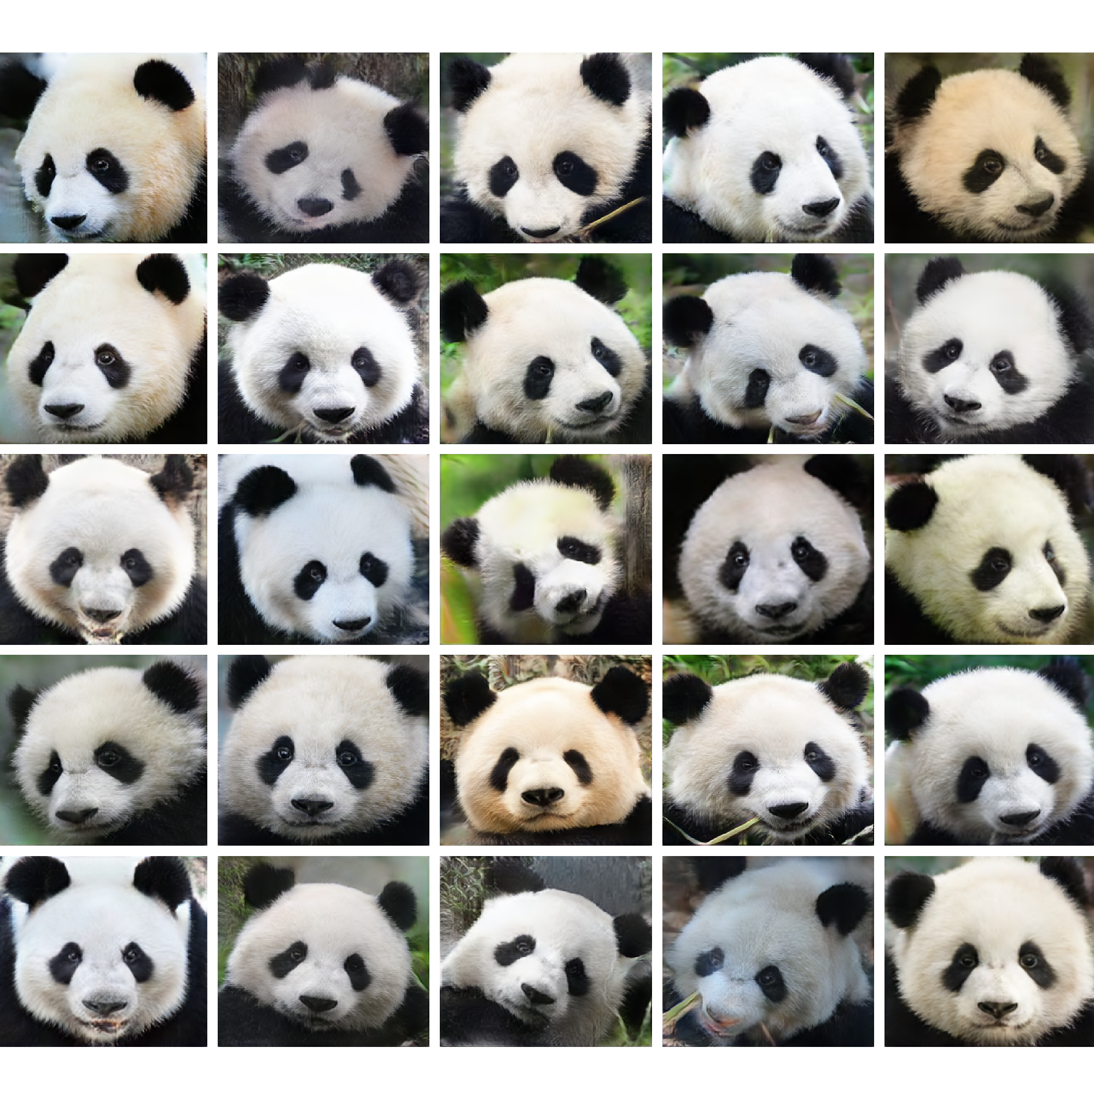
Comparison: panda dataset
Our result
Original work’s result

Slide 20
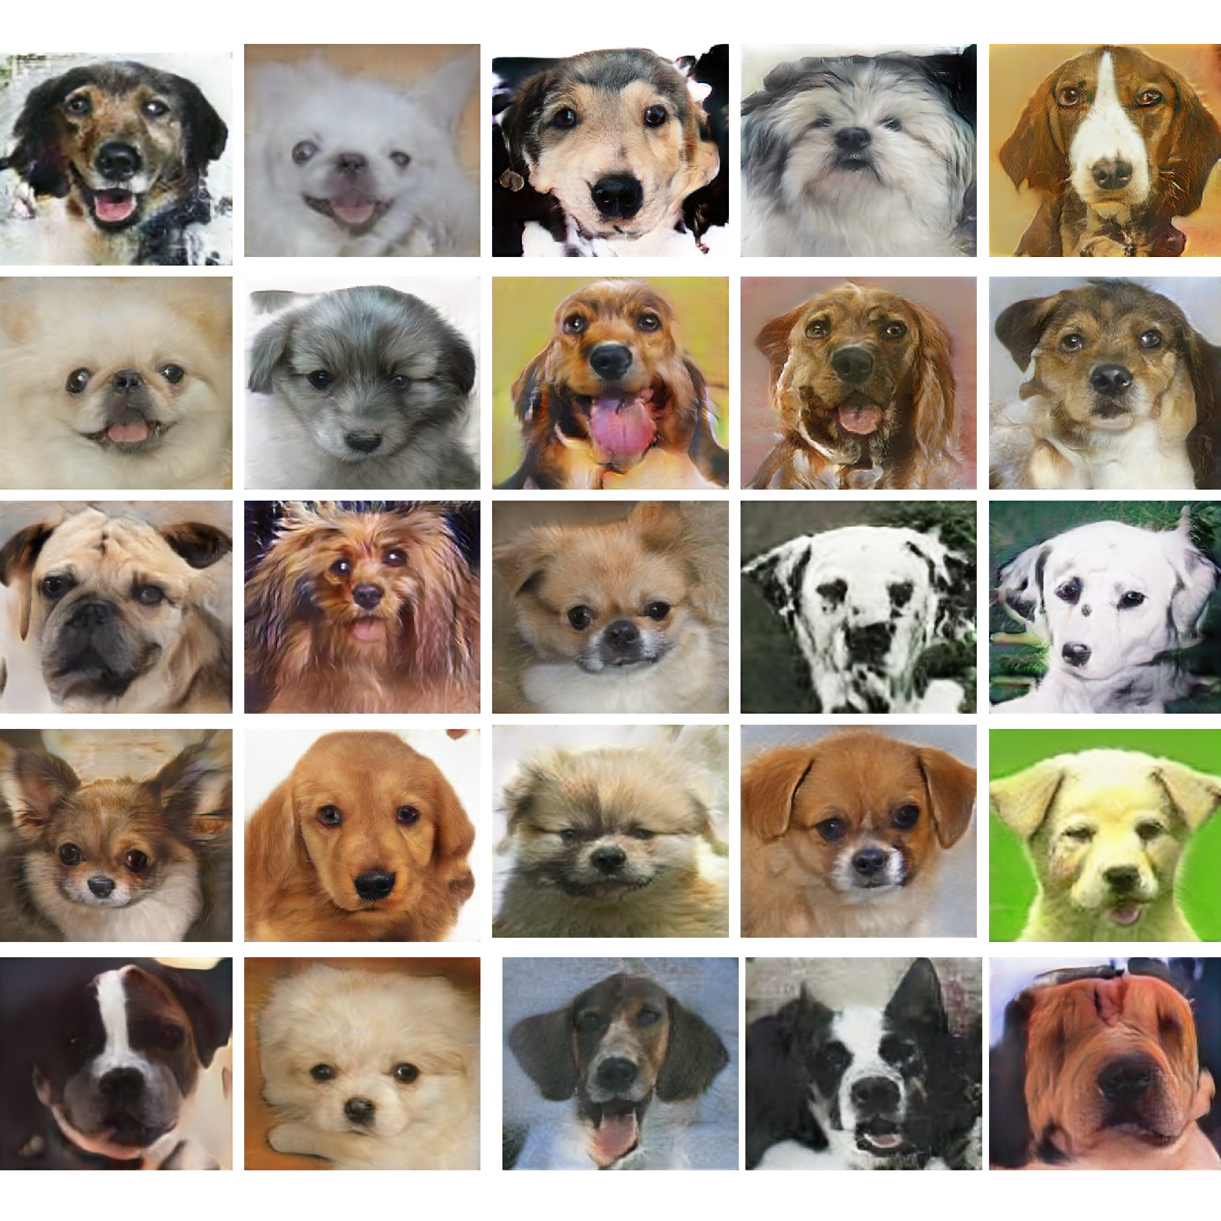
Comparison: dogs dataset
Our result
Original work’s result

Slide 21
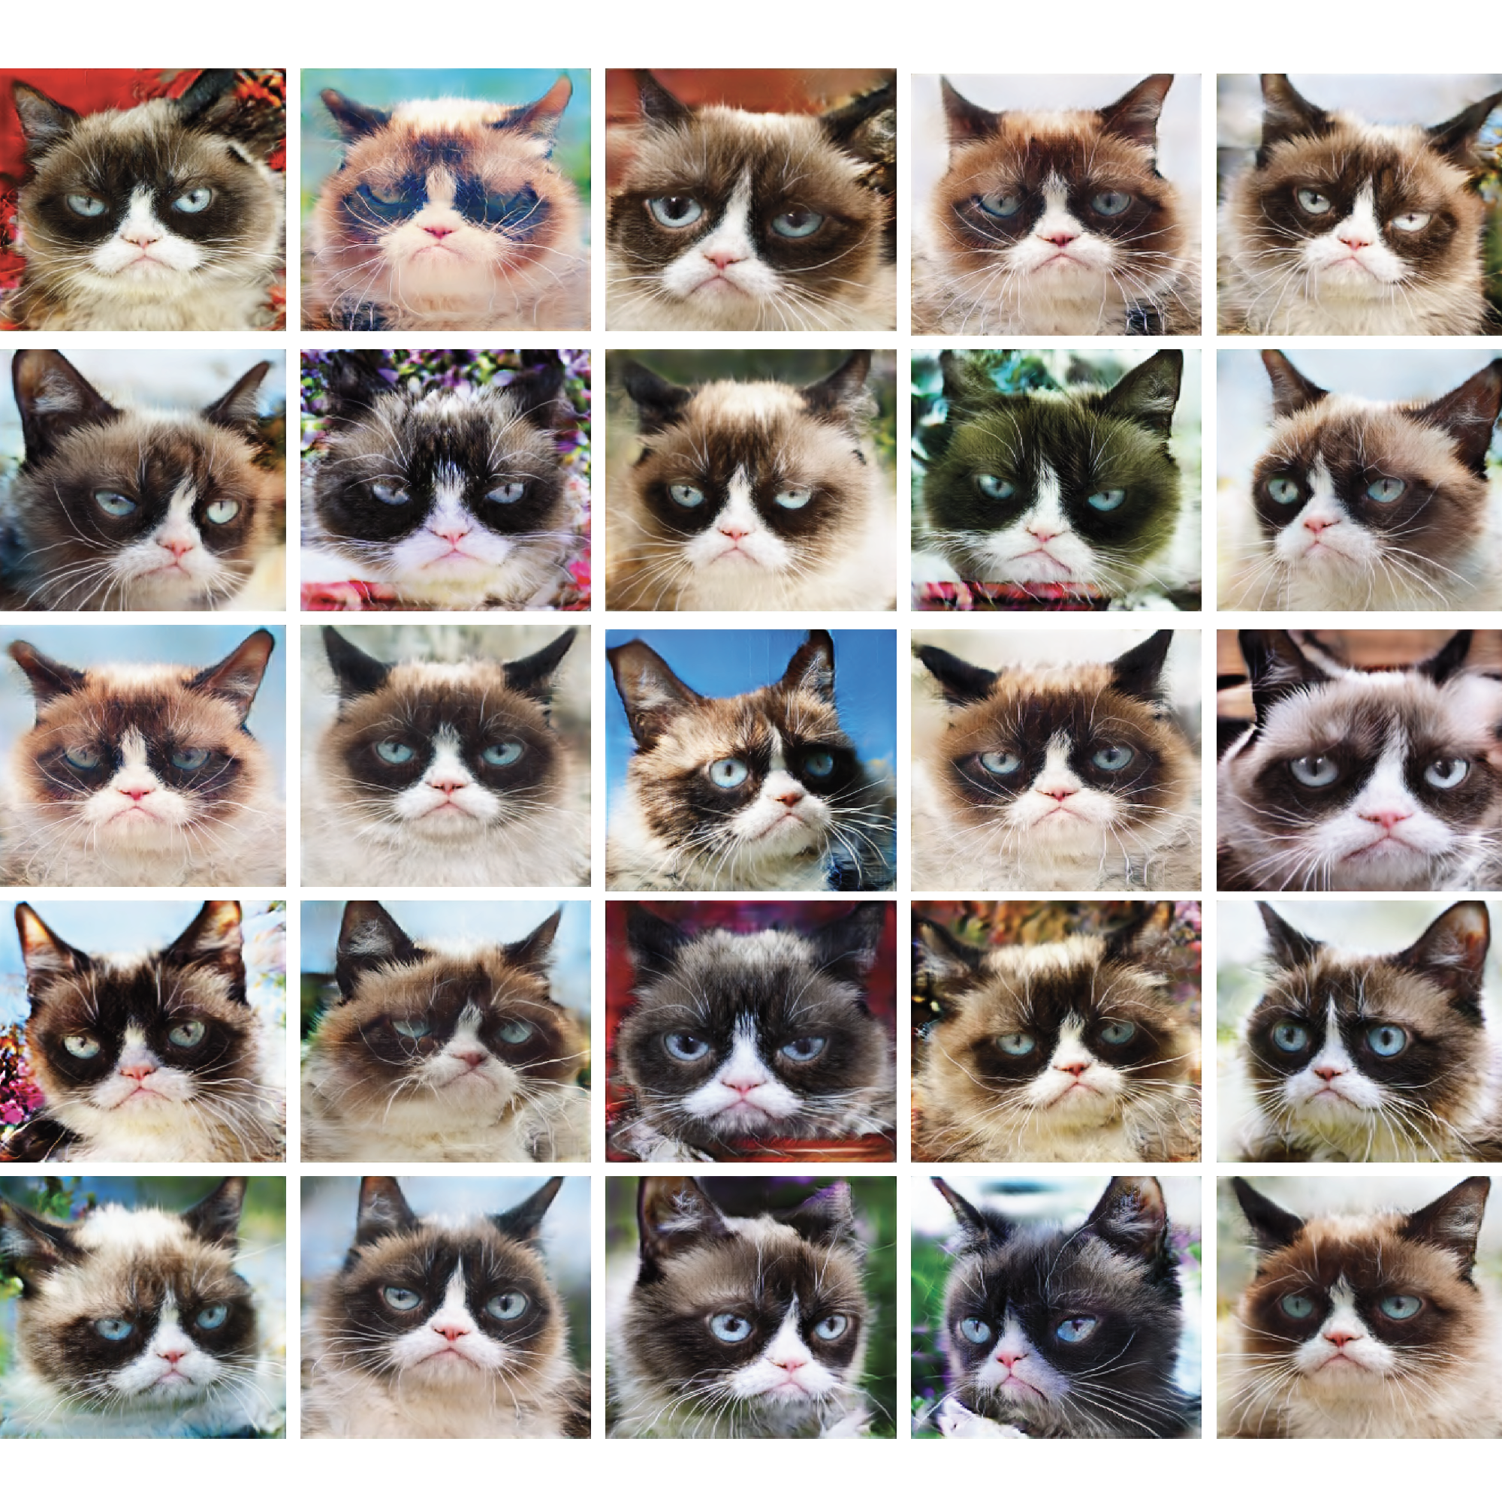
Comparison: grumpy cat dataset
Our result
Original work’s result

Slide 22
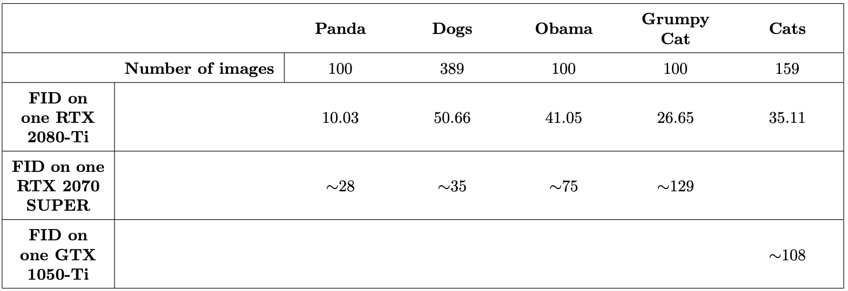
COMPARISON WITH ORIGINAL WORK
FID score comparison between original paper (using RTX 2080-Ti) and ours (using NVIDIA GeForce RTX 2070 SUPER and NVIDIA GeForce GTX 1050-Ti).

Slide 23
Conclusions
Thanks to FastGAN improvements, given small datasets (sub-hundred images) and limited computing resources, GAN training can be stabilized with an improved synthesis quality using skip-layer excitation mechanism (SLE) and self-supervised regularization on the discriminator, which boost synthesis performance of the GAN.
Obviously, we obtained worse results with respect to the original work, since we had more limited computing resources; said that, these results were still considerable.

Slide 24

end

